Slide 1
TEACHER’S PERSONAL INFORMATION
Name: Nguyen Thanh Loan
Facebook: Loan Nguyễn Thanh
Mobile number: 0942 255 937
Email: loannguyenthanh1978@gmail.com
Zalo lớp:
DH19LG1-TA3A-010112284301
https://zalo.me/g/suwnaq219

Slide 2
ONLINE ASSIGNMENTS
https://www.helbling-ezone.com
Course: DH19LG1-TA3A-010112284301
Course ID: UJXM-YFGE

Slide 3

UNIT 7
DANGER

Slide 4
CONTENTS
Vocabulary: dangers, animals, fears and phobias.
Grammar: comparison, -ing forms and phobias.
Function: giving yourself time to think.

Slide 5
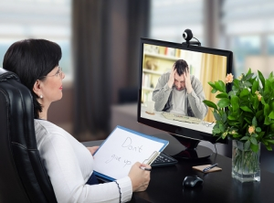

LESSON 3
WHAT ARE YOU AFRAID OF?
psychology
/saɪˈkɒl.ə.dʒi/
the scientific study of the way the human mind works and how it influences behaviour, or the influence of a particular person's character on their behaviour

Slide 6
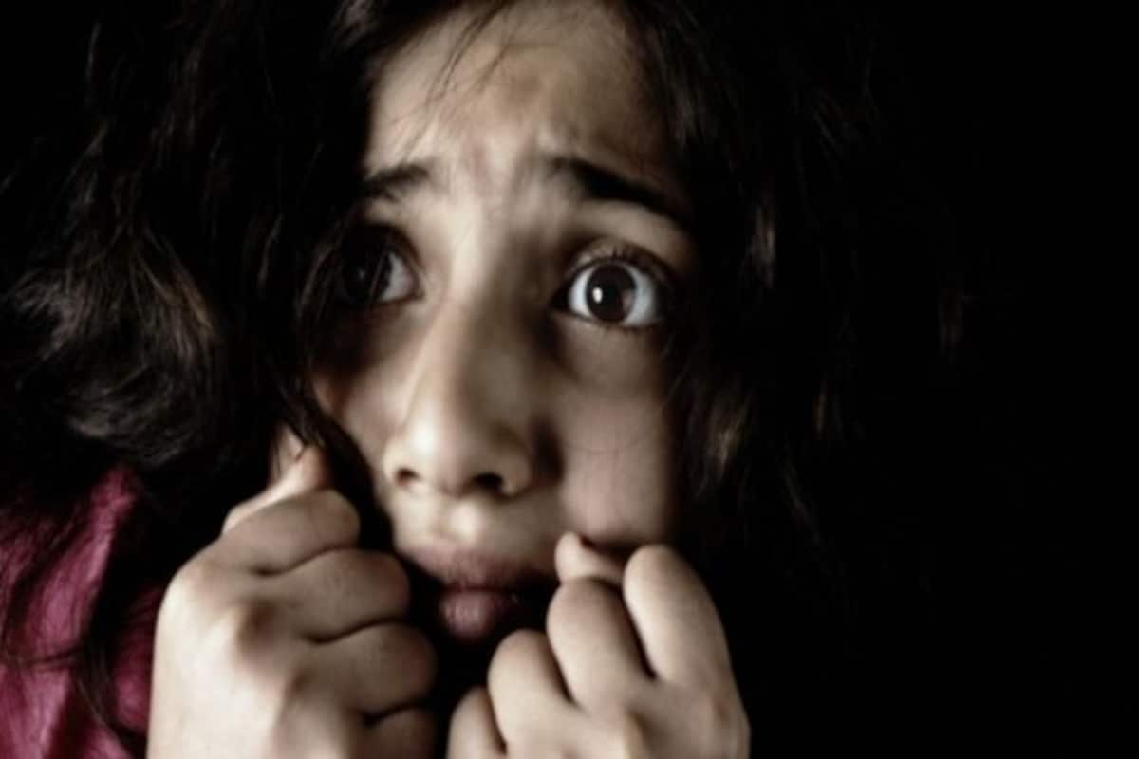
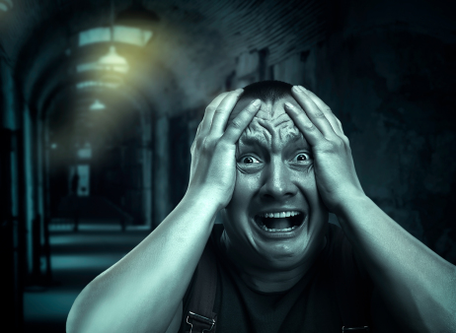
VOCABULARY
PHOBIAS
phobia
/ˈfəʊ.bi.ə/
a type of anxiety disorder (= a mental illness that makes someone very worried and affects their life) that involves an extreme fear of something

Slide 7
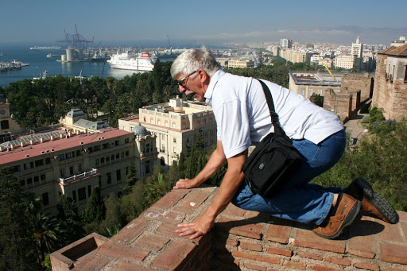
VOCABULARY
TYPES OF PHOBIAS
acrophobia
fear of heights
/ˌæk.rəˈfəʊ.bi.ə/

Slide 8
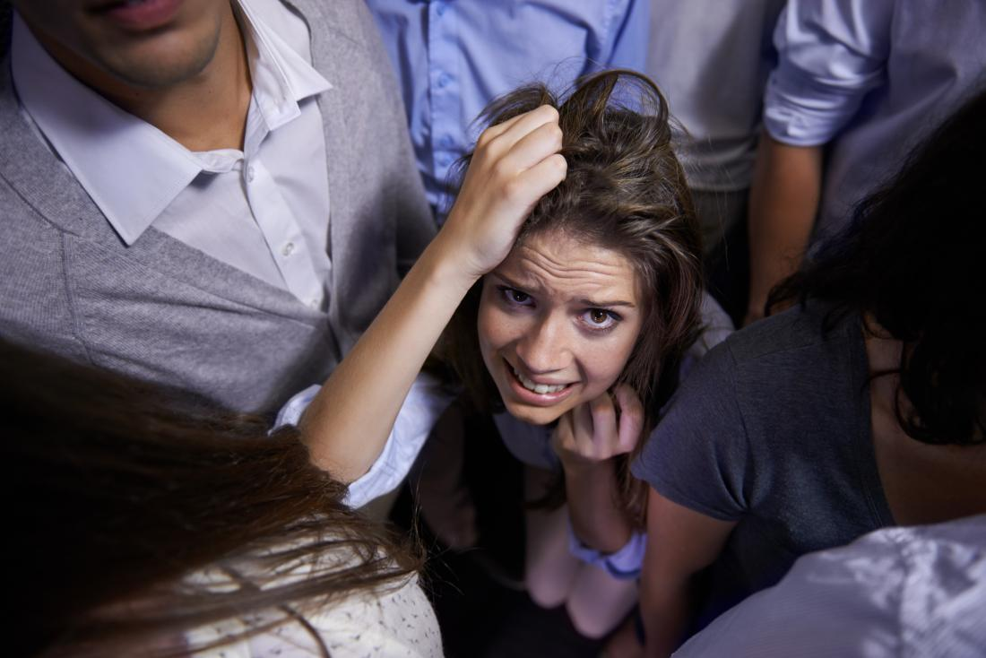
VOCABULARY
TYPES OF PHOBIAS
agoraphobia
fear of open spaces or crowded public places
/ˌæɡ.ə.rəˈfəʊ.bi.ə/

Slide 9
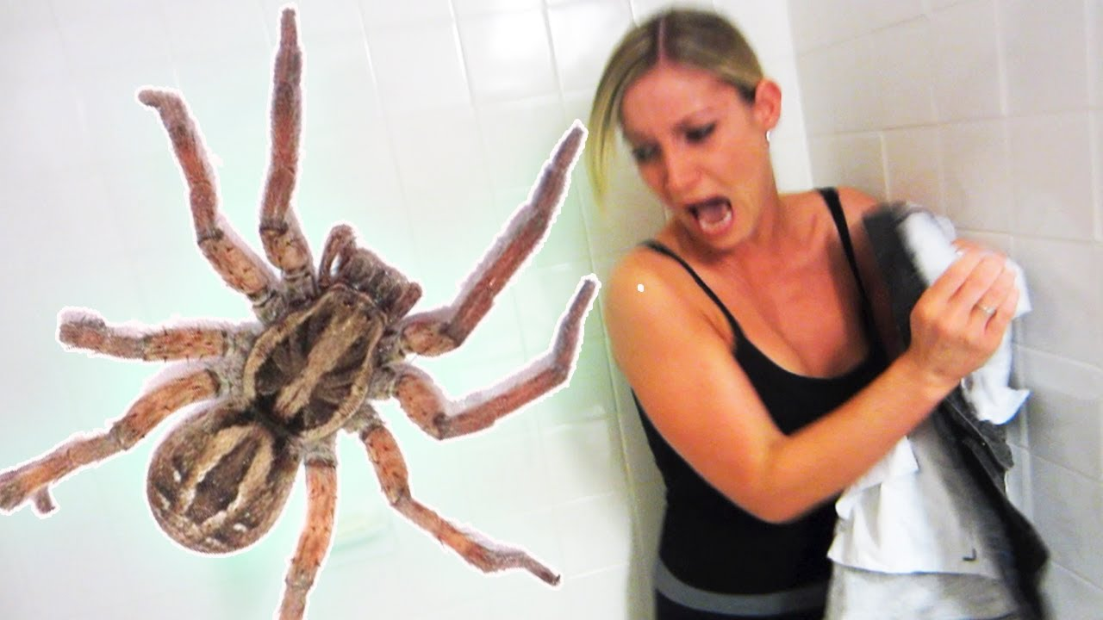
VOCABULARY
TYPES OF PHOBIAS
arachnophobia
fear of spiders
/əˈræk.nəˌfəʊ.bi.ə/

Slide 10
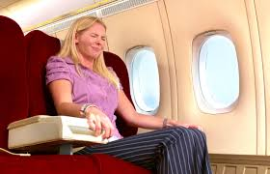
VOCABULARY
TYPES OF PHOBIAS
aerophobia
fear of flying
/ˌeə.rəˈfəʊ.bi.ə/

Slide 11

VOCABULARY
TYPES OF PHOBIAS
/
bibliophobia
fear of books

Slide 12
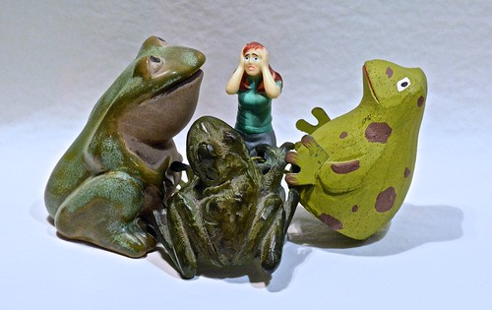
VOCABULARY
TYPES OF PHOBIAS
ranidaphobia
fear of frogs

Slide 13
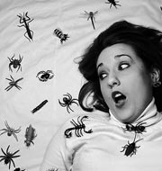
VOCABULARY
TYPES OF PHOBIAS
insectophobia
fear of insects

Slide 14
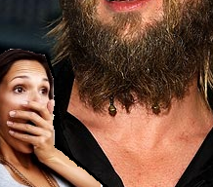
VOCABULARY
TYPES OF PHOBIAS
pogonophobia
fear of beards

Slide 15
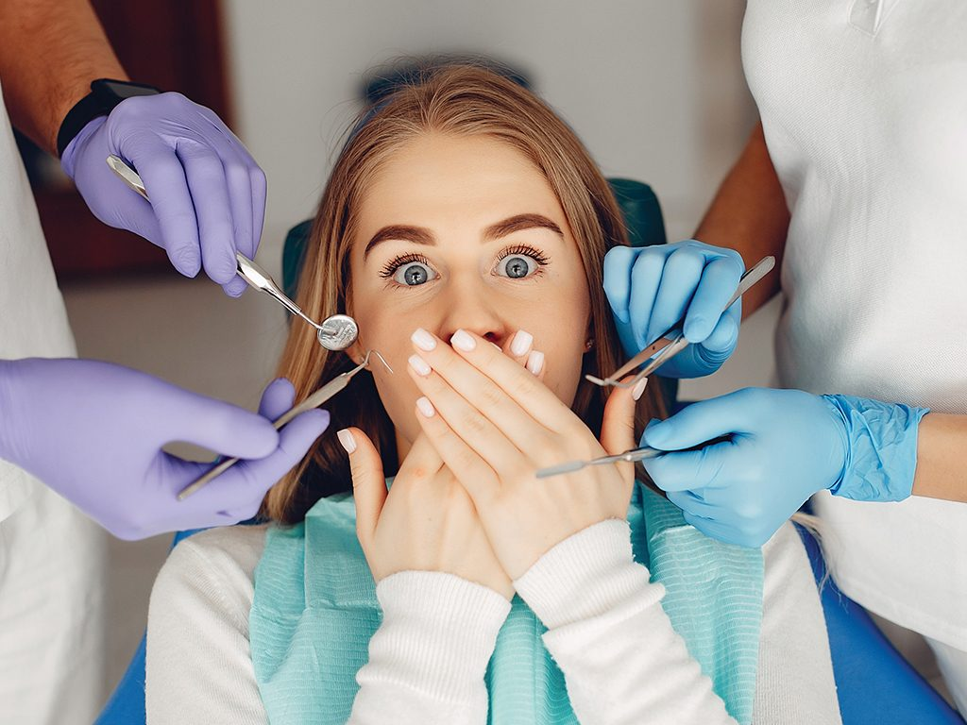
VOCABULARY
TYPES OF PHOBIAS
dentophobia
fear of dentists

Slide 17

LISTENING (T 07)
Listen to four people talking about their fears and complete the table.
Person | What was he/she afraid of? | What does he/she do?
1 | heights | He avoids going tall buildings or mountains.
2 | flying | She doesn’t fly. She goes by train or bus whenever she can.
3 | water | He never goes in deep water.
4 | snakes | She does nothing because it isn’t exactly a problem in New York city.
Person | What was he/she afraid of? | What does he/she do?
1 | (1) _________ | He avoids going (2) …………………or (3) …………..........
2 | (4) _________ | She (5) ………... . She goes by (6) …………………or (7) ……… whenever she can.
3 | (8) _________ | He never goes in (9)…………………..
4 | (10) _________ | (11)…………………….

Slide 18
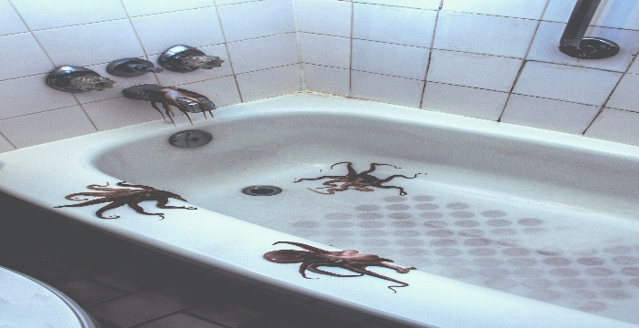


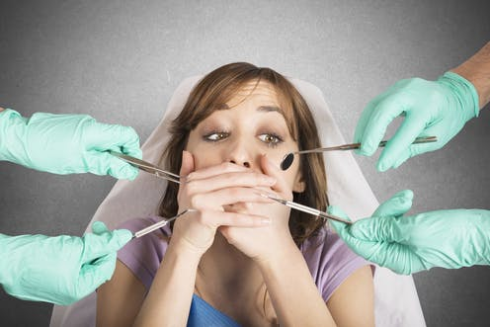
SPEAKING
REARS
Finding a spider in the shower
singing karaoke in front of my friends
taking a test / an exam
Going to the dentist

Slide 19
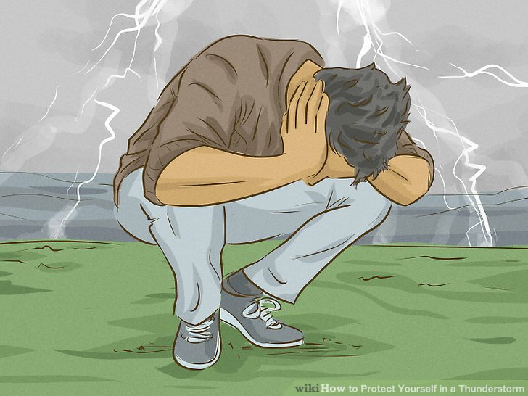
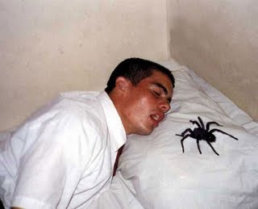
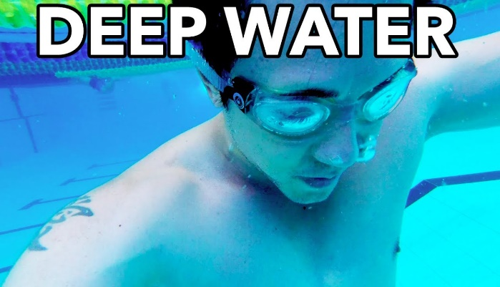
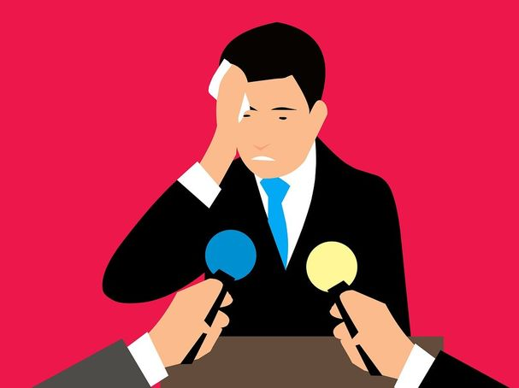
SPEAKING
REARS
Being in a thunderstorm
Finding a spider in my bed
Swimming in very deep water
Talking in front of a group of people

Slide 20
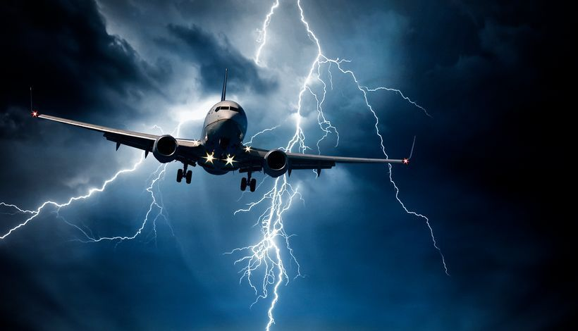
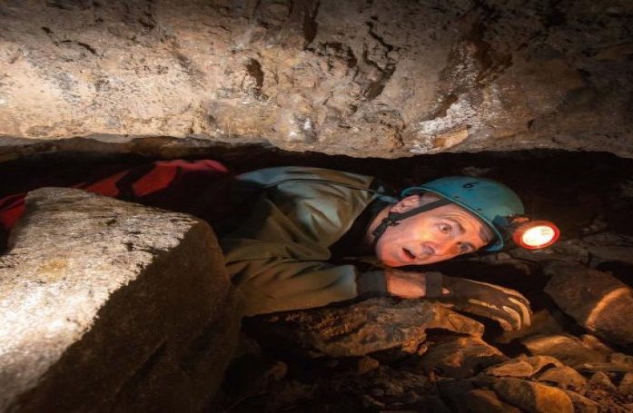
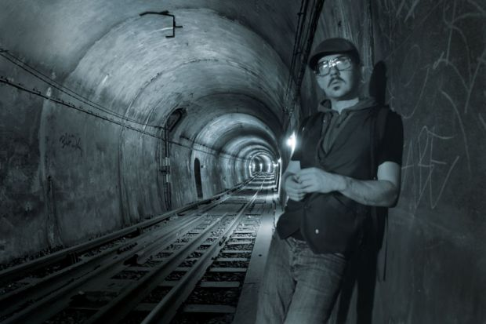
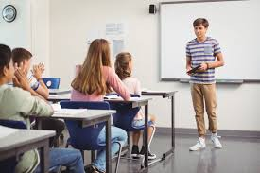
SPEAKING
REARS
Flying through bad weather in a plane
Going into a dark cave
Going underground tunnel
Speaking English in my E. class

Slide 21



Slide 22

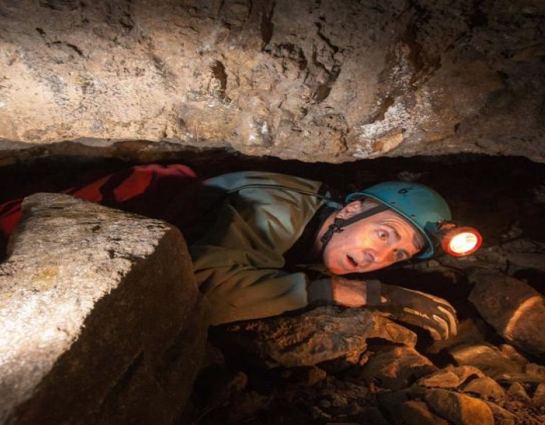

Slide 23
SPEAKING
Ask and answer about your fear.
A: What are you afraid of?
B: I’m afraid of speaking English in my English class.

Slide 24
GRAMMAR
ING forms as Nouns
1. As the Subject of a sentence. Making Game is my hobby
Ex: Speaking English in my English class is a problem for me.

Slide 25
GRAMMAR
ING forms as Nouns
2. As the Object of a sentence (after verbs: like, dislike, hate; prepositions: of, with, to, from…).
Ex: I am afraid of speaking English in my English class.

Slide 26
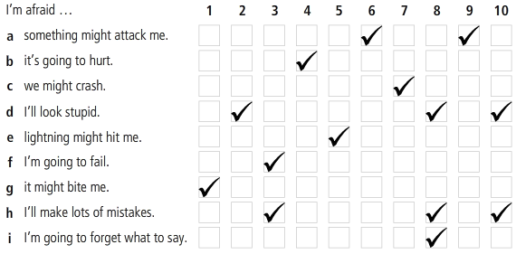
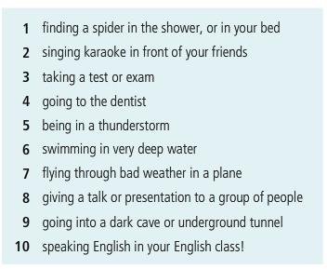
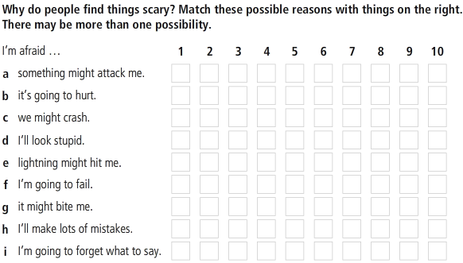
SPEAKING
REARS

Slide 27
SPEAKING
Why do people find things scary?
1. I’m afraid of going to the dentist because it’s going to hurt.
2. I’m afraid of going into a dark cave because someone might attack me.
Exercise 7: page 9

Slide 28
SPEAKING
Agreeing and disagreeing
Agreeing | Disagreeing
I agree, ……. That’s true. Absolutely, | I don’t agree,…. I’m not sure about that, That’s a good point, but
A: I think going to the dentist is terrifying.
B: I disagree. Singing karaoke is worse. That should be number 1.
A: I think swimming in deep water is the most terrifying.
B: I disagree. Flying through bad weather in a plane is the most terrifying.

Slide 29
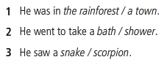
Why do people find things scary?
LISTENING 2
Two friends are talking about a frightening experience one of them had. Listen and circle the correct answers

Slide 30
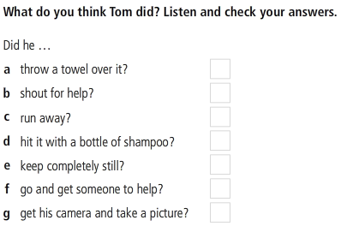
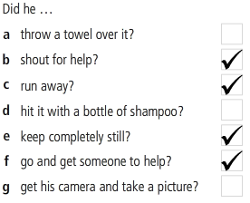
LISTENING 2

Slide 31
FERENCES
Vocabulary
https://www.youtube.com/watch?v=qBw6eHhz7NM
Grammar
https://www.youtube.com/watch?v=u3JcvH-AfsY
Listening
https://www.youtube.com/watch?v=sMerc3qRWPQ
https://www.youtube.com/watch?v=3vfn7jBqGZM

Slide 32
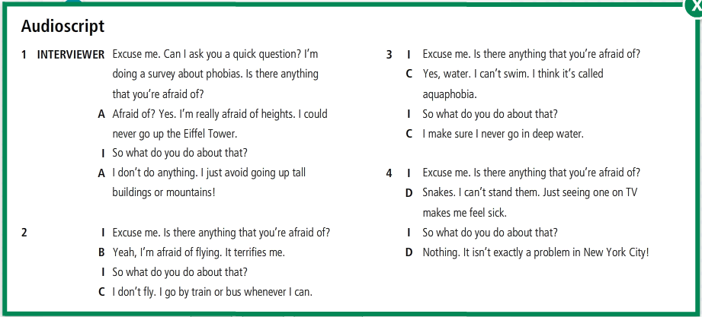

Slide 33
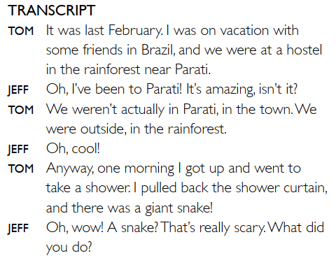

Slide 34
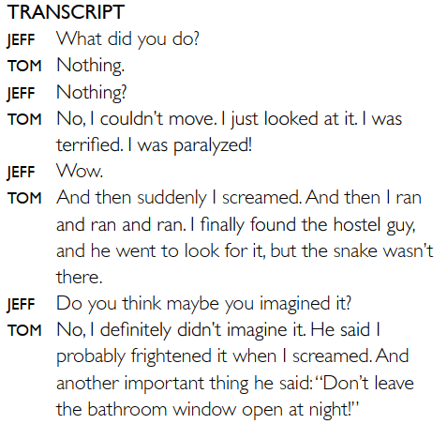

Slide 35
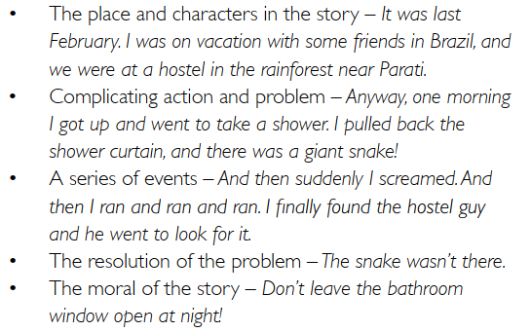
WRITING
Write a short paragraph about a scary experience you have had. Use the questions to help.
1. When was it?
4. What did you do?
2. What happened?
5. Who were you with?
3. Where were you?
6. Was it OK in the end?
Reference

Slide 36
The end!

